Slide 1




DETECTION OF DROWSINESS OF
DRIVER’S FACE THROUGH IOT
By Group - 4
Nipun Rajput
Ketan Thakur
Godavarthi Sai Nikhil
Utkarsh Singh
Mentor : Dr. Nirupama MP
LETS GET STARTED

Slide 2


LIST OF CONTENT
PRESENTATION
01
02
03
04
CONTENT ONE
CONTENT TWO
CONTENT THREE
CONTENT FOUR
PROJECT
OBJECTIVES
DELIVERABLES
Hardware and Software Components
Methodology and Experimental Results

Slide 3
LIST OF CONTENT
PRESENTATION
05
06
07
08
CONTENT FIVE
CONTENT SIX
CONTENT SEVEN
CONTENT EIGHT
Demonstration
Role/
Contribution
Future Scope and Application
References

Slide 4



PROJECT
OBJECTIVES
Through this project, we are trying to reduce accidents happening due to drowsiness.
Before the driver has lost all consciousness, the system will detect the early signs of drowsiness and alert them that they are no longer capable of moving safely.
However, this system cannot guarantee that the driver will be fully alert and that an accident will not occur. It's just a tool for enhancing driver safety, with a focus on lengthy truck drivers, nighttime drivers, those driving long distances alone, and people who are deprived of sleep.
To use a buzzer or an alarm to warn the driver whenever drowsiness is detected.

Slide 5

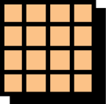

DELIVERABLES
ACHIEVEMENT ONE
ACHIEVEMENT TWO
As per discussed,
We have Submitted the online simulation in the First Sem.
Fully functional/demonstrable prototype has been build by us

Slide 6




Hardware and Software Components
Hardware Components are
Raspberry pi 4
Pi Camera sensor
32 Gb Sd Card
LCD (Display Board)
Buzzer
Relay Module
Vibration Sensor
Software Components are
Python – python 3.10
Libraries like Numpy, Dlib, imutils, opencv, Scipy. Etc.

Slide 7

METHODOLOGY
Eye Detection
Recognition of eye’s state
Eye state determination
Drowsiness detection

Slide 8
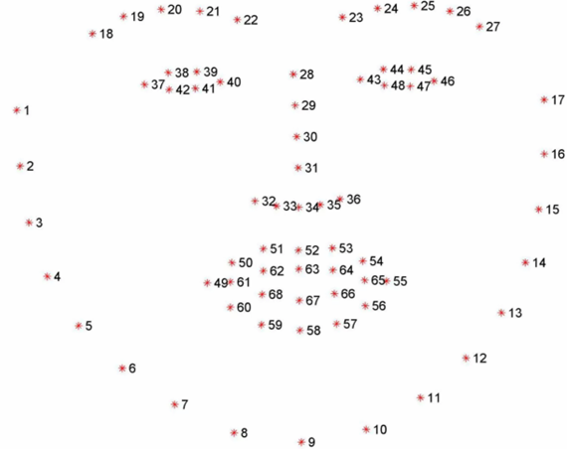
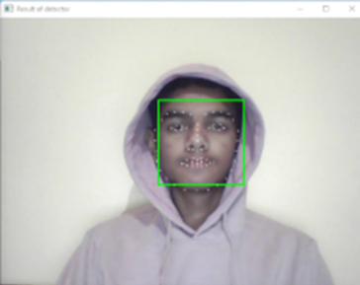
1.EYE DETECTION
Dlib Library
68 landmark detector
Euclidean distance

Slide 9
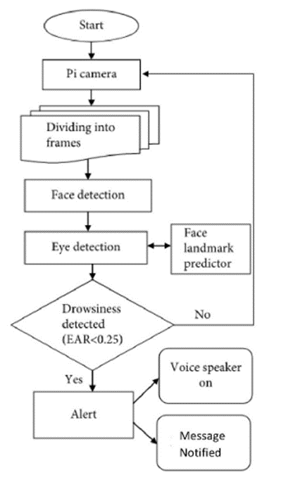
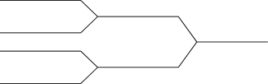
2.Recognition of eye’s state
Flow Chart of the Process

Slide 10

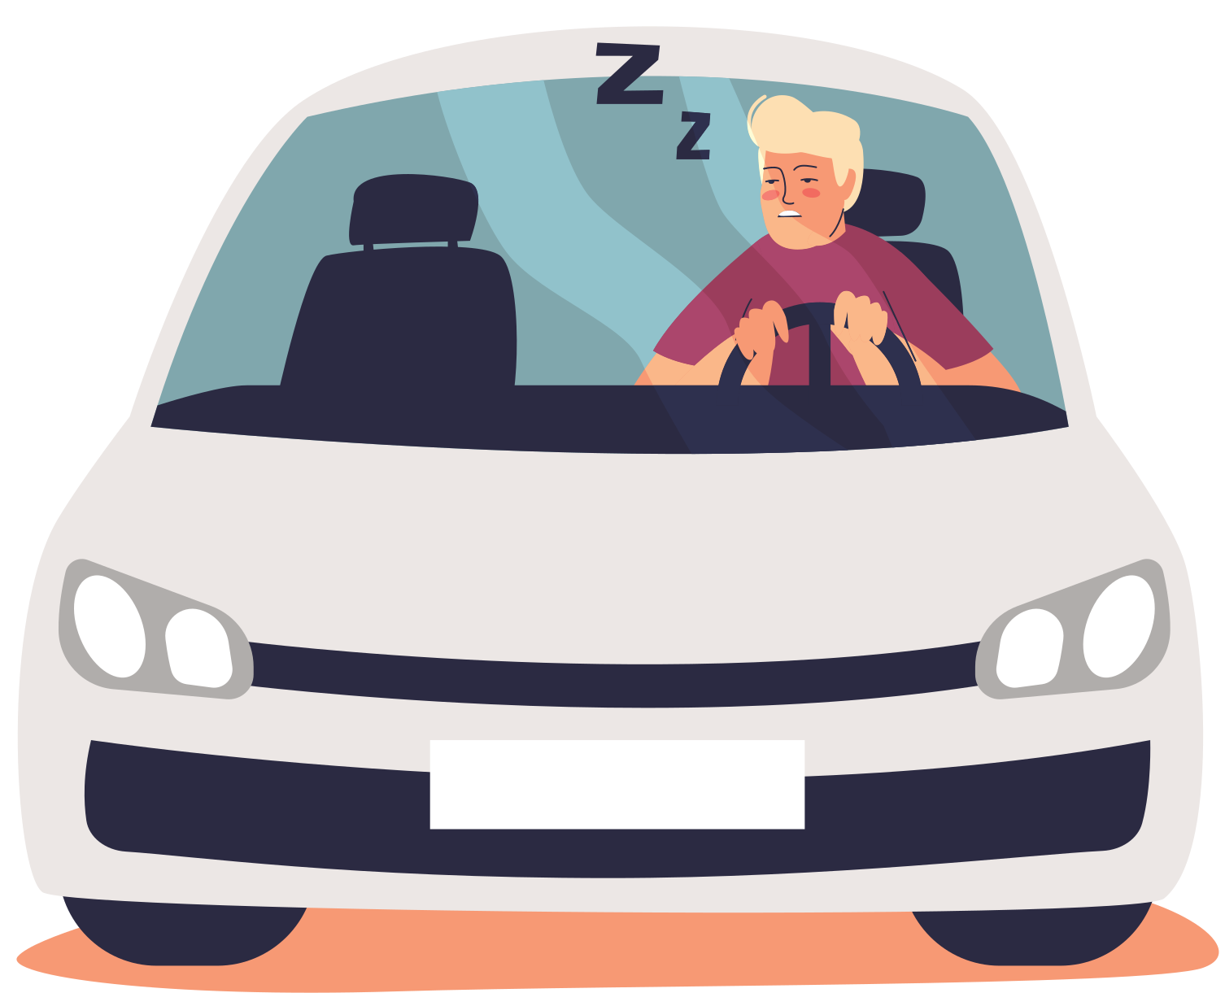
3. Eye state determination
4. Drowsiness detection

Slide 11
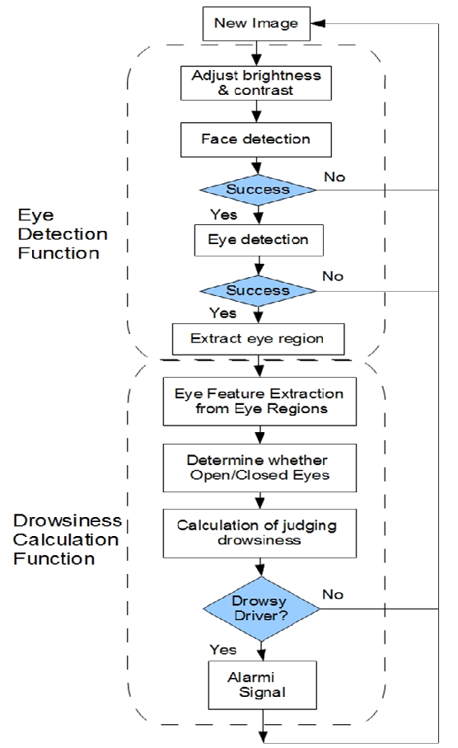






Block Diagram
Face, eye, and sleepiness detection are the three steps of the proposed method.
The images from the tracked eye are used to identify drowsiness and create warning alarms.
The face detection algorithm starts with image frames that have been collected and then processes them.
Euclidian distance is then used to monitor the eyes of the discovered face

Slide 12


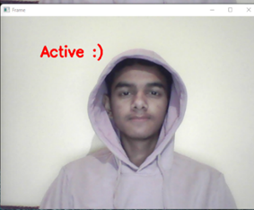
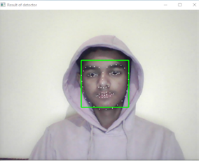
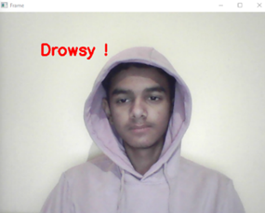
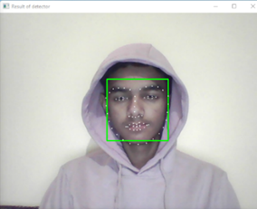
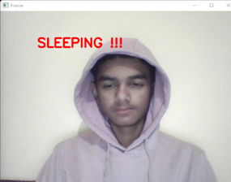
EXPERIMENTAL RESULTS

Slide 13

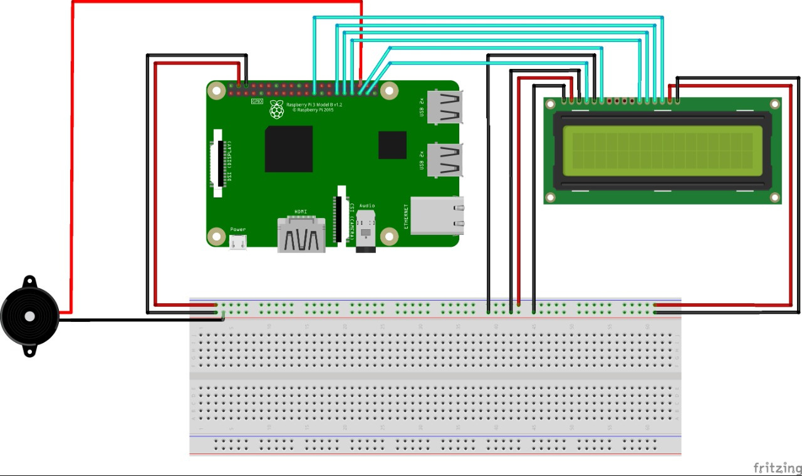


Circuit Diagram:
LCD Display
Raspberry pi 4
Buzzer

Slide 14
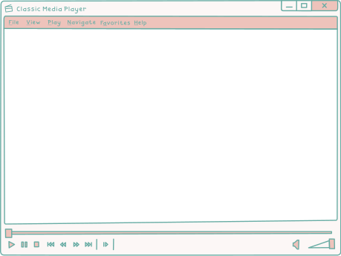
DEMONSTRATION
DEMONSTRATION

Slide 15

ROLE AND CONTRIBUTION
NIPUN RAJPUT
PRESENTATIONS/CODING
KETAN THAKUR
SOFTWARE/CODING
GODAVARTHI SAI NIKHIL
HARDWARE/REPORTS
TEAMWORK
UTKARSH SINGH
HARDWARE

Slide 16

Future Scope and Application
The device can also be attached to the accelerator to reduce the vehicle's speed to reduce the number of the accident.
The system can be improved even more by employing an infrared camera for better picture quality in a variety of lighting circumstances, as well as for persons with brown complexions and small eyes.

Slide 17
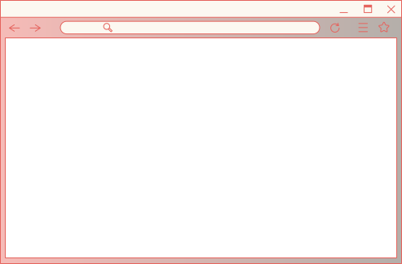
References
R. A. ZOROOFI & P.R TABIZI- ‘FOR OPEN AND CLOSED EYE ANALYSIS TO DETECT DROWSINESS’.
R.L HSU AND A.K JAIN - ‘FOR DETECTING THE COLOUR IMAGES OF FACE’.
P.E HART – ‘FOR DETECTING LINES AND CURVES IN THE PICTURE’.
K.C YOWAND – ‘FOR DETECTING HUMAN FACE’. ‘IMAGE VISION’.
N.AHUJA, M.H YANG – ‘DETECTION OF FACES IN THE IMAGE’.

Slide 18
